Slide 1
Red-Black Trees and AA Trees
Node Color, Insertions and Rotations
SoftUni Team
Technical Trainers
Software University
http://softuni.bg

Slide 2
Table of Contents
Red-Black Tree
Simple Representation of a 2-3 Tree
Rebalancing Trees
Rotations
Insertion Algorithm
AA Tree
Insertion Algorithm

Slide 3
13
11
41
7
73
5
9
50
3
Red-Black Tree
Simple Representation of a 2-3 Tree

Slide 4
Why Yet Another Balanced BST?
We want operations to happen at:
O(log(n)) not O(h) where h in worst case is n
AVL vs Red-Black trees:
The AVL trees are more balanced that causes more rotations during insertion and deletion
if your application involves many frequent insertions and deletions, then Red Black trees should be preferred

Slide 5
Representing 3-Nodes from 2-3 Tree
We will represent 3-nodes with a left-leaning red nodes
Nodes with values between the 2 nodes will be to the right of the red node
30
20
30
20

Slide 6
Red-Black Tree Properties
All leaves are black
The root is black
No node has two red links connected to it
Every path from a given node to its descendant leaf nodes contains the same number of black nodes
Red links lean left

Slide 7

Rebalancing Trees
Rotations

Slide 8
Rotations
Rotations are used to correct the balance of a tree
Balance can be measured in height, depth, size etc. of subtrees
17
Right subtree weights more
25
90

Slide 9
Left Rotation
Orient a right-leaning red link to lean left
In Order Preserved
y
x
Left rotation (y)
x
y

Slide 10
Right Rotation
Orient a left-leaning red link to lean right (temporarily)
In Order Preserved
x
y
Right rotation (x)
y
x

Slide 11
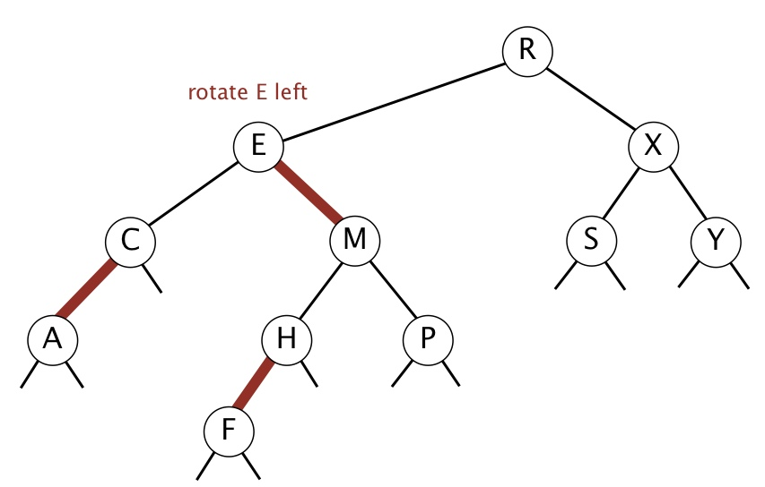
Rotations - Quiz
R E X C M S Y A H P F
R M X E H S Y C F P A
R M X E P S Y C H A F
R C X A E S Y M H P F

Slide 12
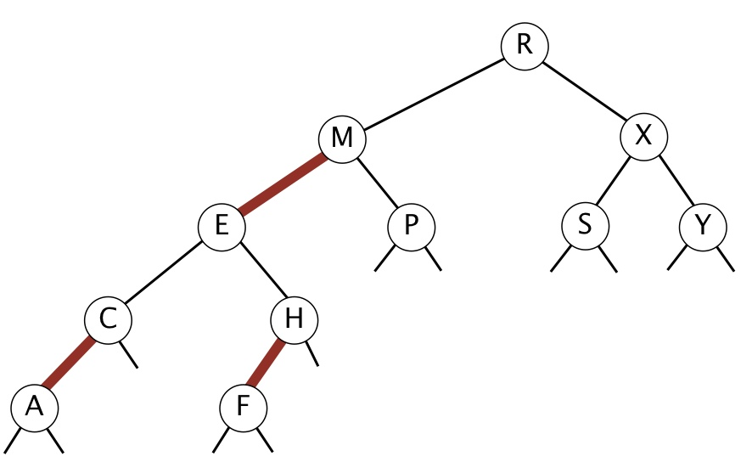
Rotations - Answer
R E X C M S Y A H P F
R M X E H S Y C F P A
R M X E P S Y C H A F
R C X A E S Y M H P F

Slide 13
13
11
41
7
73
5
9
50
3
Red-Black Tree
Insertion Algorithm

Slide 14
Insertion Algorithm
Locate the node position
Create new red node
Add the new node to the tree
Balance the tree if needed

Slide 15
Insertion
Larger element
Insert into a single 2-node:
Smaller element
The red node is leaning right, we need left rotation
73
73
80
50
80
The red node is leaning left
73

Slide 16
Insertion (2)
Insert smaller item into a 2-node at the bottom:
13
11
41
The red node is leaning left
7
73
5
9
50

Slide 17
Insertion (3)
Insert larger item into a 2-node at the bottom:
13
13
11
41
11
41
7
73
7
80
5
9
80
5
9
73
The red node is leaning right
Left rotation

Slide 18
Insertion Into 3-Node
3 cases:
The element is smaller than both keys
The element is larger than both keys
The element is between the 2 keys

Slide 19
Insertion Into 3-Node (2)
Larger than both keys:
Flipping the colors increases the tree height, which maintains the 1-1 correspondence to 2-3 trees
13
13
Flip the colors
11
41
11
41

Slide 20
Insertion Into 3-Node (3)
Smaller than both keys:
13
Left-Heavy tree, needs right rotation
11
11
9
13
9
11
9
13
Flip the colors

Slide 21
Insertion Into 3-Node (4)
Between the keys:
30
50
Right-Leaning red link - Left Rotation
20
50
20
30
50
30
30
20
50
20

Slide 22
Flipping Colors
Flipping the colors should also change the parent color to red
Preserves perfect black balance in the tree!
void flipColors(Node<T> node) {
node.color = RED;
node.left.color = BLACK;
node.right.color = BLACK;
}

Slide 23
Keeping Black Root
Insert on a single node (root):
Each time the root switches colors, the height of the tree is increased
30
30
30
20
50
20
50
20
50

Slide 24
Insert Into 3-Node at the Bottom
Insert 8
5
5
3
19
3
18
1
18
1
8
19
5
8
3
18
1
8
19

Slide 25
Insert Into 3-Node at the Bottom (2)
18
5
5
19
3
18
3
8
1
8
19
1

Slide 26
Overall Insertion Process
Left
Rotate
Right Rotate
Flip
Colors

Slide 27
5
3
18
1
8
19
Red-Black Tree
Insertion Implementation

Slide 28
Changes to the BST Class
class RedBlackTree<T> {
private static final boolean RED = true;
private static final boolean BLACK = false;
private static class Node<T> {
public boolean color;
public Node(T value, bool color) {
// TODO: Add setup logic here
}
}

Slide 29
Changes to the BST Class (2)
class RedBlackTree<T> {
private boolean isRed(Node<T> node)
private Node<T> rotateLeft(Node<T> node)
private Node<T> rotateRight(Node<T> node)
private void flipColors(Node<T> node)
}

Slide 30
Rotate Right
private Node<T> rotateRight(Node<T> node) {
Node<T> temp = node.left;
node.left = temp.right;
temp.right = node;
temp.color = node.color;
node.color = RED;
node.count = 1 + count(node.left) + count(node.right);
return temp;
}

Slide 31
Rotate Left
private Node<T> rotateLeft(Node<T> node) {
Node<T> temp = node.right;
node.right = temp.left;
temp.left = node;
// Same operations as rotateRight()
return temp;
}

Slide 32
Insert
private boolean isRed(Node<T> node) {
if (node == null) return false;
return node.color;
}
public void insert(T element) {
this.root = this.insert(element, this.root);
this.root.color = BLACK;
}

Slide 33
Insert(2)
private Node<T> insert(T element, Node<T> node) {
if (node == null) node = new Node<>(element, RED);
// Recursive calls to go left or right
if (this.isRed(node.right) && !this.isRed(node.left))
node = this.rotateLeft(node);
if (this.isRed(node.left) && this.isRed(node.left.left))
node = this.rotateRight(node);
if (this.isRed(node.left) && this.isRed(node.right))
this.flipColors(node);
// Increase count
}

Slide 34
Red-Black Tree - Quiz
TIME’S UP!
TIME:
Suppose that you insert n keys in ascending order into a red-black BST. What is the height of the resulting tree?
Constant
Logarithmic
Linear
Linearithmic

Slide 35

Red-Black Tree - Answer
Suppose that you insert n keys in ascending order into a red-black BST. What is the height of the resulting tree?
Constant
Logarithmic
Linear
Linearithmic
The height of any red–black BST on n keys (regardless of the order of insertion) is guaranteed to be between log₂n and 2log₂n

Slide 36
Red-Black Tree - Summary
Structure | Worst case |  |  | Average case
 | Search | Insert | Delete | Search Hit | Insert
BST | N | N | N | 1.39 lg N | 1.39 lg N
2-3 Tree | c lg N | c lg N | c lg N | c lg N | c lg N
Red-Black | 2 lg N | 2 lg N | 2 lg N | lg N | lg N

Slide 37
AA Tree
Definition

Slide 38
Why AA Trees
Red-Black vs AA trees:
The implementation and number of rotation cases in Red-Black Trees is complex. AA trees simplifies the algorithm
It eliminates half of the restructuring process by eliminating half of the rotation cases, which is easier to code
It simplifies the deletion process by removing multiple cases

Slide 39
AA Tree
Utilizes the concept of levels
Level - the number of left links on the path to a null node
17
Level 3
9
25
Level 2
5
12
22
32
Level 1

Slide 40
AA Tree
AA tree invariants
The level of every leaf node is one
Every left child has level one less than its parent
Every right child has level equal to or one less than its parent
Right grandchildren have levels less than their grandparents
Every node of level greater than one has two children

Slide 41
AA Tree
Right horizontal links are possible
Left horizontal links are not allowed
17
Level 3
9
25
Level 2
5
10
12
22
32
55
Level 1

Slide 42
Skew
Skew operation is a single right rotation
Skew when an insertion or deletion creates a horizontal left link
17
Level 3
9
25
Level 2
5
10
12
22
32
55
Level 1

Slide 43
Skew (2)
Skew operation is a single right rotation
Skew when an insertion or deletion creates a horizontal left link
17
Level 3
9
25
Level 2
5
10
12
22
32
55
Level 1

Slide 44
Split
Split operation is a single left rotation
Split when an insertion or deletion two consecutive right horizontal links
17
Level 3
9
25
Level 2
5
10
12
22
32
55
71
Level 1

Slide 45
Split
Split operation is a single left rotation
Split when an insertion or deletion two consecutive right horizontal links
17
Level 3
9
25
55
Level 2
5
10
12
22
32
71
Level 1

Slide 46
AA Tree
Insertion Algorithm

Slide 47
AA Tree Insertion #1
Insert: 6
New nodes are always inserted at Level 1
Level 3
Level 2
6
Level 1

Slide 48
AA Tree Insertion #1
Insert: 2
Level 3
Level 2
6
Level 1

Slide 49
AA Tree Insertion #1
Left horizontal link is not allowed
Rotate right (skew)
6
Level 3
Level 2
2
6
Level 1

Slide 50
AA Tree Insertion #1
Insert: 8
Level 3
Level 2
2
6
Level 1

Slide 51
AA Tree Insertion #1
Insert: 8
Level 3
Level 2
2
6
Level 1

Slide 52
AA Tree Insertion #1
Insert: 8
Level 3
Level 2
2
6
Level 1

Slide 53
AA Tree Insertion #1
Two consecutive right horizontal links
Rotate left (split)
2
Level 3
Level 2
2
6
8
Level 1

Slide 54
AA Tree Insertion #1
Insert: 16
Level 3
6
Level 2
2
8
Level 1

Slide 55
AA Tree Insertion #1
Insert: 16
Level 3
6
Level 2
2
8
Level 1

Slide 56
AA Tree Insertion #1
Insert: 16
Level 3
6
Level 2
2
8
Level 1

Slide 57
AA Tree Insertion #1
Insert: 16
Level 3
6
Level 2
2
8
16
Level 1

Slide 58
AA Tree Insertion #1
Insert: 10
Level 3
6
Level 2
2
8
16
Level 1

Slide 59
AA Tree Insertion #1
Insert: 10
Level 3
6
Level 2
2
8
16
Level 1

Slide 60
AA Tree Insertion #1
Insert: 10
Level 3
6
Level 2
2
8
16
Level 1

Slide 61
AA Tree Insertion #1
Horizontal left link not allowed
Rotate right (skew)
16
Level 3
6
Level 2
2
8
16
Level 1
10

Slide 62
AA Tree Insertion #1
Two consecutive right horizontal links
Rotate left (split)
8
Level 3
6
Level 2
2
8
10
16
Level 1

Slide 63
AA Tree Insertion #1
Two consecutive right horizontal links
Rotate left (split)
8
Level 3
6
10
Level 2
2
8
16
Level 1

Slide 64
Trees - Quiz
Consider web application in which
searches are far more frequent than insertions/deletions
Which of the following do you prefer:
AVL
Linked List
Red-Black
B+
TIME’S UP!
TIME:

Slide 65
Trees - Quiz
Consider web application in which
searches are far more frequent than insertions/deletions
Which of the following do you prefer:
AVL
Linked List
Red-Black
B+
TIME’S UP!
AVL trees are more rigidly balanced, so they have faster search

Slide 66

Summary
…
…
…
Red-Black Trees are widely used
Insertion is easy
Balance by color
Color is a single byte
AA Trees
Insertion algorithm

Slide 67
https://softuni.bg/modules/59/java-advanced

Slide 68













SoftUni Diamond Partners

Slide 69

Educational Partners

Slide 70
Trainings @ Software University (SoftUni)
Software University – High-Quality Education, Profession and Job for Software Developers
softuni.bg, about.softuni.bg
Software University Foundation
softuni.foundation
Software University @ Facebook
facebook.com/SoftwareUniversity
Software University Forums
forum.softuni.bg
70
Notes:
70

Slide 71

License
This course (slides, examples, demos, exercises, homework, documents, videos and other assets) is copyrighted content
Unauthorized copy, reproduction or use is illegal
© SoftUni – https://about.softuni.bg/
© Software University – https://softuni.bg
Notes:
71

